Slide 1

EMPLOYEE RETENTION
HR ANALYTICS

Slide 2
PROJECT NAME : HR ANALYTICS ( EMPLOYEE RETENTION )
D. ROHIT NAIDU
R.ROHAN
MENTOR
D.RAMYA SREE
Abdul Rahman
K.SOWJANYA
YOGITA SHARMA
G . AKHILESH

Slide 3
AGENDA
Introduction
Objective
KPI’S
Dashboard
Conclusion

Slide 4

Introduction
Keeping good employees is a big problem for companies. When they leave, it can hurt how well the company works, what it knows, and how everyone gets along. This HR Analytics project is all about using data to understand why employees stay or leave

Slide 5
Business Objective
Employee retention is a critical aspect of HR analytics, and setting clear business objectives for a project in this domain is essential for success. Here are some business objectives you might consider for an employee retention project in HR analytics:
Reduce Turnover Rate
Enhance Employee Engagement
Cost Reduction
Develop Retention Strategies
Evaluate HR Policies
Continuous Monitoring and Adjustment

Slide 6
KPI’S
Average attrition rate for all Departments
Average hourly rate of Male Research Scientist
Attrition rate Vs Monthly Income stats
Average working years for each Department
Job role Vs Work life balance
Attrition rate Vs Years Since last promotion

Slide 7
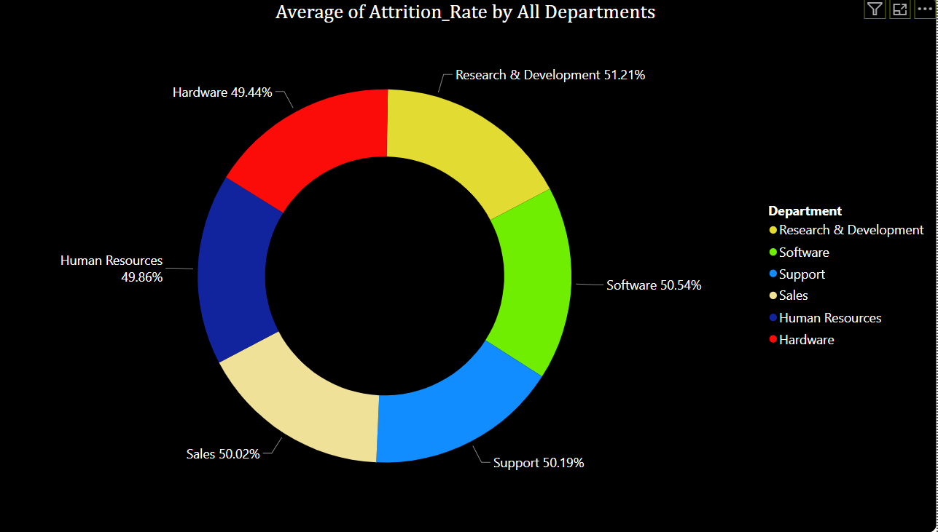
KPI 1 Average Attrition rate for all Departments
This KPI is to find out the
relationship between each
department and its attrition rate and here attrition rate is highest for Research & Development Department whereas lowest is for Hardware Department.

Slide 8
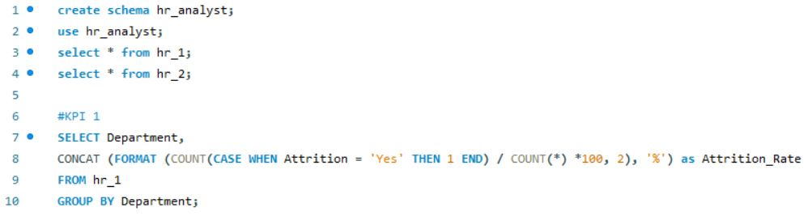
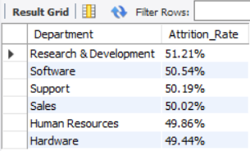
Insights from KPI 1:
We can clearly say that attrition rate of employees for every department is almost 50% which indicates that attrition rate of employees does not depends on department. So, irrespective of the department almost 50% of employees are leaving the company.
From this calculation and visualization we concluded that we must make strong strategies to minimize attrition rate and improve our company’s Employee retention so that we can balance the company’s growth and right talent.

Slide 9
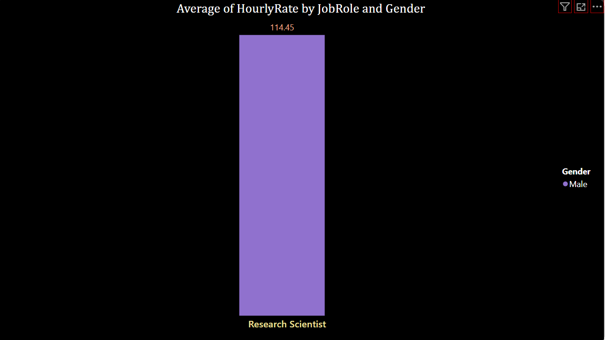
KPI 2 Average Hourly rate of Male Research Scientist
Insights from KPI 2 :
This KPI is to find out the average hourly rate of male research scientists which is 114.45.

Slide 10
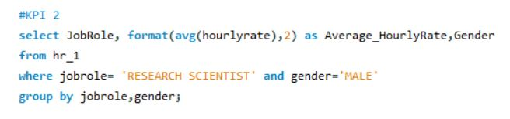
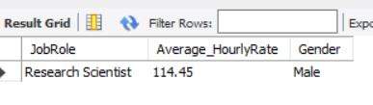

Slide 11
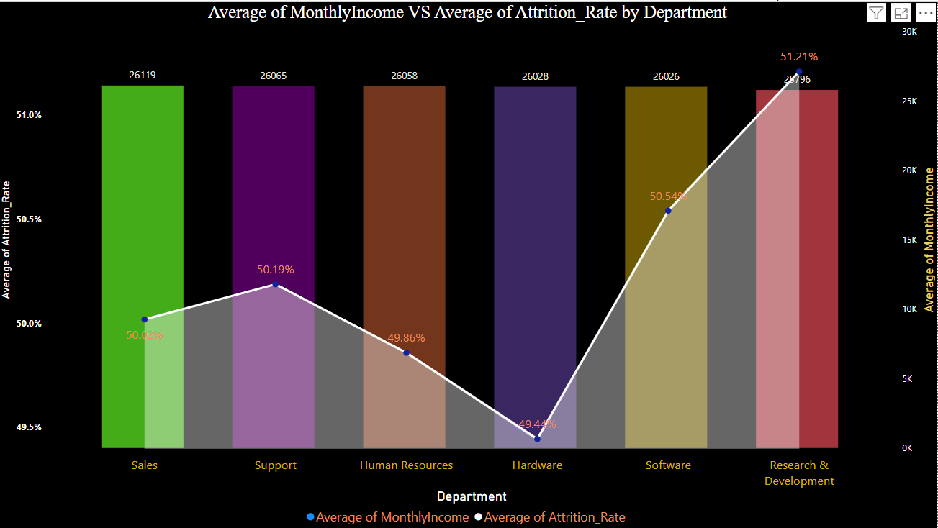
KPI 3 Attrition Rate Vs Monthly Income Stats
This KPI is to find out the relation the between monthly income and Attrition rate.

Slide 12
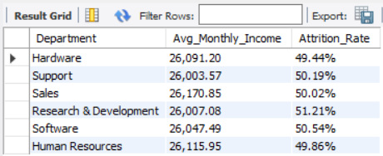
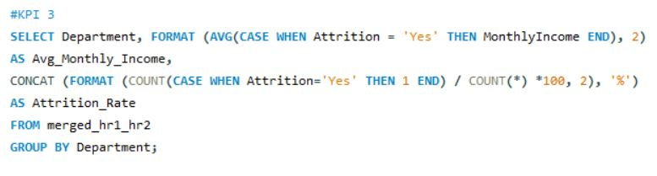
Insights from KPI 3:
Based on our analysis and visualization, it is evident that the Hardware Department has the lowest attrition rate of 49.44%, with an average monthly income of Rs. 26,091.20. On the other hand, the Research and Development Department has the highest attrition rate of 51.21%, with an average monthly income of Rs. 26,007.08

Slide 13
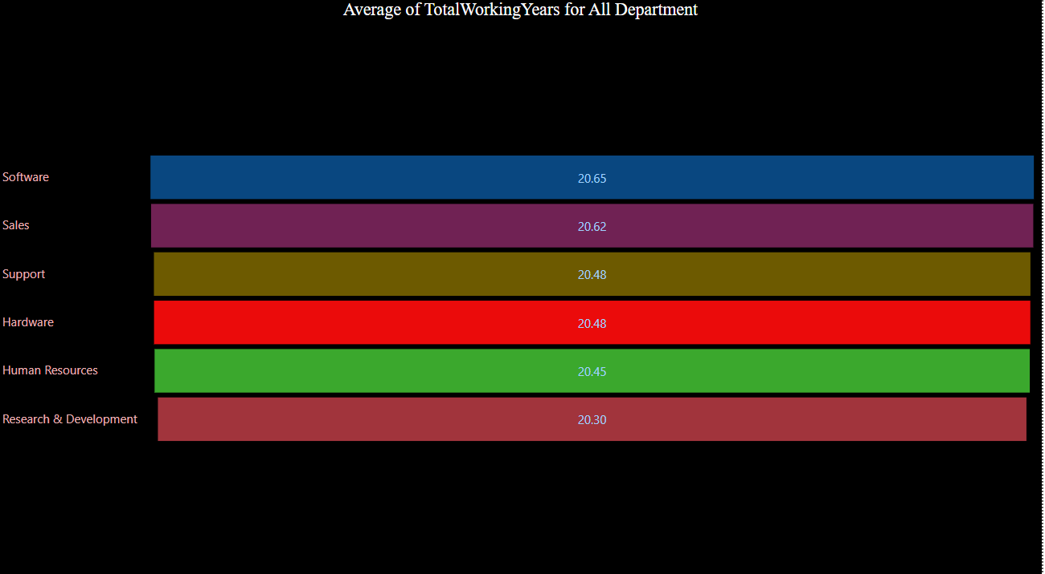
KPI 4 Average Working Years for each Department

Slide 14
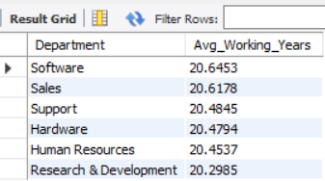
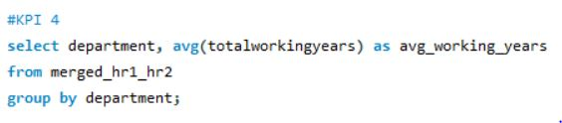
Insights from KPI 4:
From this we can see the average working years in software department is high as compared to the rest of the departments and lowest is for Research & Development Department.
From the analysis we can conclude that average working years is approximately 20 for all the departments.

Slide 15
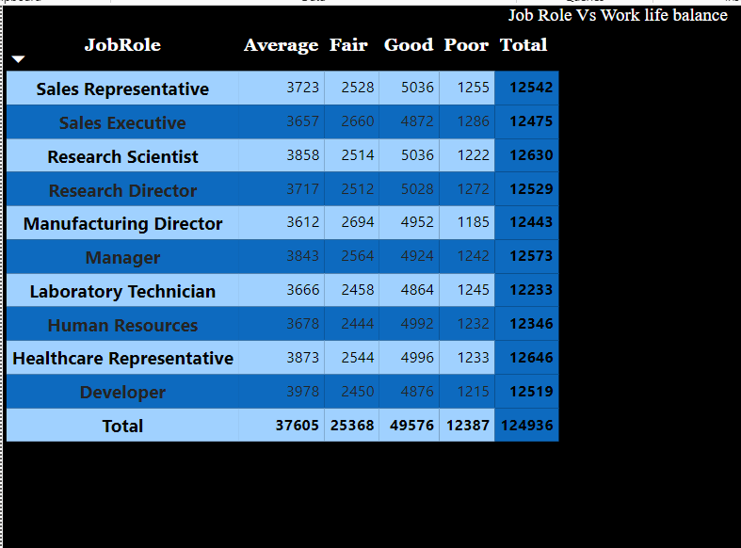
KPI 5 Job Role Vs Work Life Balance for Total Employees

Slide 16
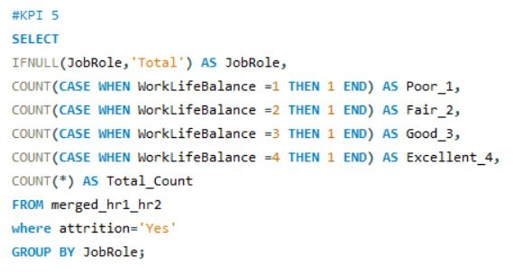
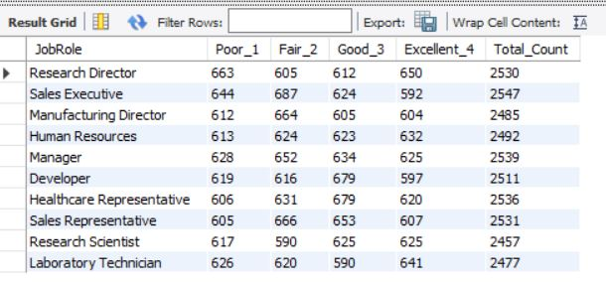
Insights from KPI 5:
From the analysis we can conclude that,
For Research directors and the sales executive the work life balance is poor.
For the Sales representatives , managers , Manufacturing Directors and the Sales executives the work life balance is fair.
For Healthcare representatives, Developers the work life balance is good.
For research director the work life balance is excellent.

Slide 17
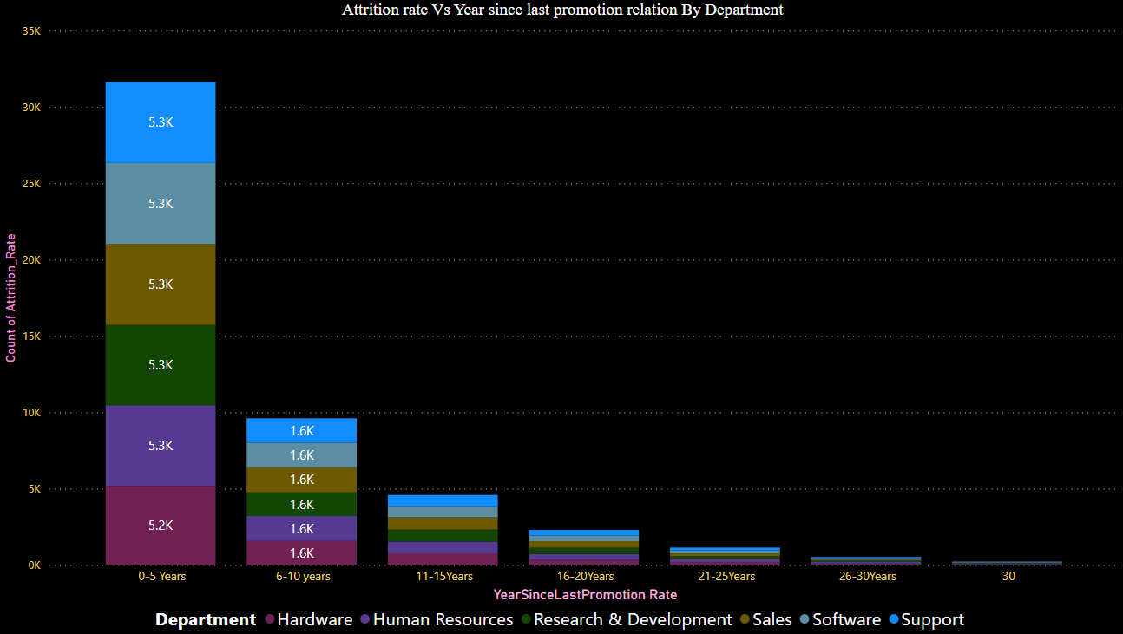
KPI 6 Attrition Rate Vs Years Since Last Promotion

Slide 18
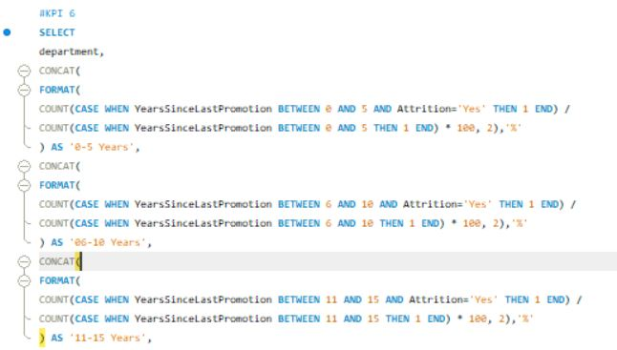
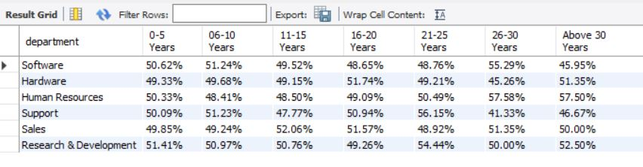
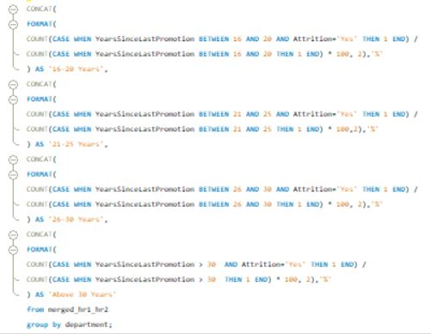

Slide 19
Insights from KPI 6:
0-5 years since Last Promotion Interval:
Highest Attrition: Research & Development
Lowest Attrition: Hardware
6-10 years since Last Promotion Interval:
Highest Attrition: Software
Lowest Attrition: Human Resources
11-15 years since Last Promotion Interval:
Highest Attrition: sales
Lowest Attrition: support
16-20 years since Last Promotion Interval:
Highest Attrition: Hardware
Lowest Attrition: Software
21-25 years since Last Promotion Interval:
Highest Attrition: Support
Lowest Attrition: Software
26-30 years since Last Promotion Interval:
Highest Attrition: Human Resources
Lowest Attrition: Support
Above 30 years since Last Promotion Interval:
Highest Attrition: Human Resources
Lowest Attrition: Software

Slide 20
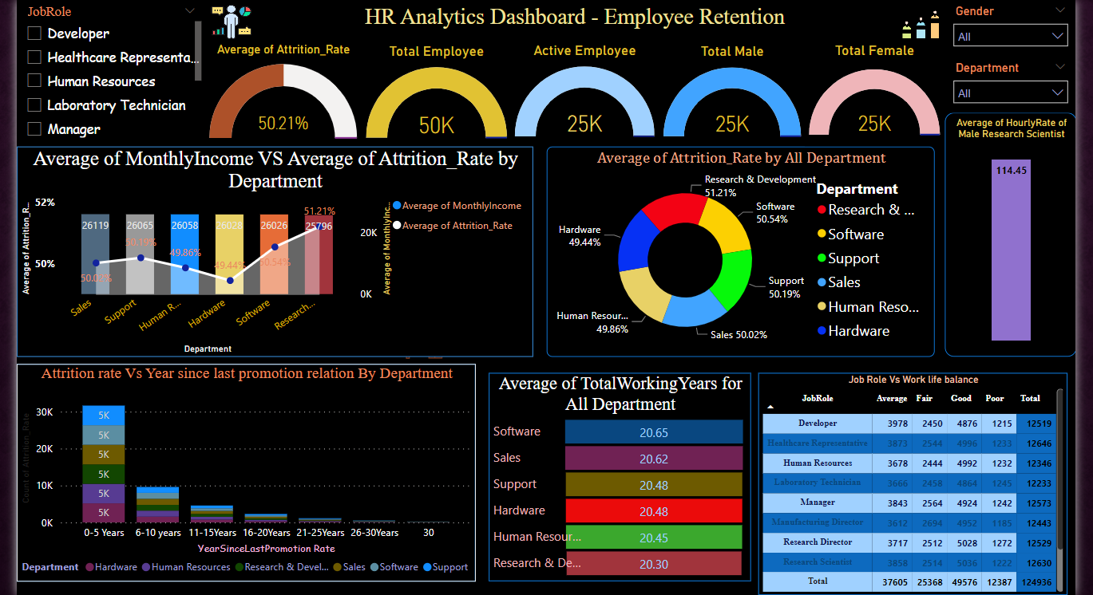

Slide 21
Conclusion
Conduct stay interviews: Instead of exit interviews, conduct stay interviews with employees to gather feedback about the job.
Improve employee engagement: Implement initiatives to improve employee engagement, such as regular feedback, recognition and rewards programs, and opportunities for career growth.
Address workload issues: Ensure employees have manageable workloads by regularly monitoring and adjusting workloads to prevent burnout and overwhelm.
Create a positive work environment: Foster a positive work environment by promoting a culture of respect, inclusivity, and teamwork. Encourage open communication and collaboration among employees.
Address pay and compensation issues: Ensure that employees receive fair pay and compensation for their work and to find out what motivates an employee to continue to work in an organization.

Slide 22
Thank you

